Slide 1
Chapter two-Simple Java programs

Slide 2
Overview of Java Programming
Java is a high level language.
1991 – Sun Microsystems initiates project “Green” with the intent to develop a programming language for digitally controlled consumer devices and computers.
The language OAK was developed by James Gosling with the goal of using C++’s popularity.
OAK was later renamed to JAVA and released in 1995.
Can be used to create two types of programs: applications and applets.
Robust: no pointers in java and no manual memory handling.

Slide 3
Overview (cnt’d)
Powerful: massive libraries.
Java programs are portable.
Java promise: “Write once, run everywhere”.
Java differs from other programming languages in that it is both compiled and interpreted language.
Java compilers produce the Java bytecode.
Java bytecodes are a set of instructions written for a hypothetical computer, known as the Java virtual machine.
Bytecodes are platform-independent.
The JVM is an interpreter for bytecode.

Slide 4
Overview (cnt’d)
An interpreter reads the byte code and translates into a sequence of commands that can be directly executed by the computer.
Because the execution of every Java program is under the control of the JVM, the JVM can contain the program and prevent it from generating side effects outside of the system.

Slide 5
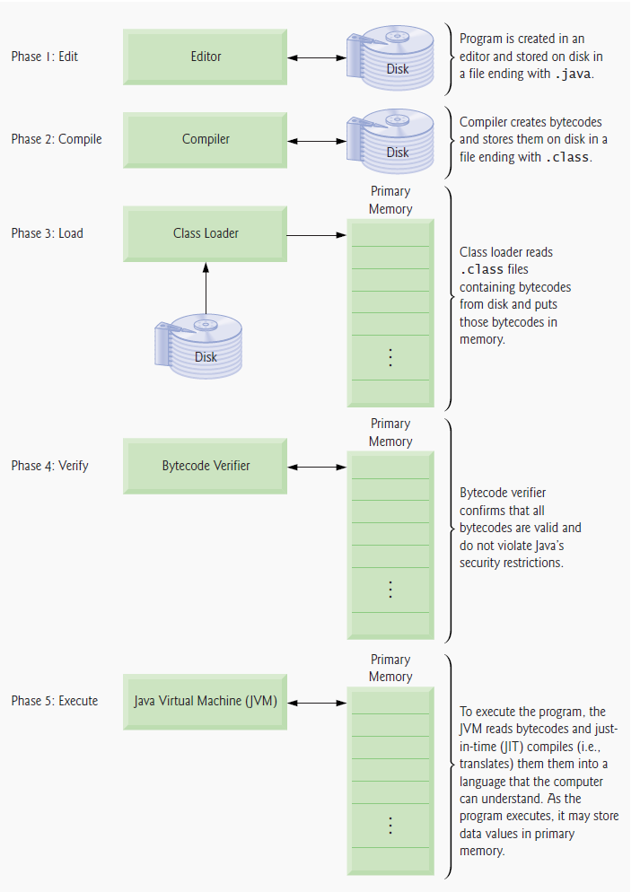
Overview (cnt’d)

Slide 6
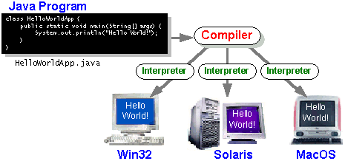

Slide 7
API, JDK, and IDE
Computer languages have strict rules of usage.
If you do not follow the rules when writing a program, the computer will be unable to understand it.
The Java language specification and Java API define the Java standard.
The Java language specification is a technical definition of the language that includes the syntax and semantics of the Java programming language.
The application program interface (API) contains predefined classes and interfaces for developing Java programs.
The Java language specification is stable, but the API is still expanding.

Slide 8
API…
Java comes in three editions:
Java Standard Edition (Java SE) - to develop client-side standalone applications or applets.
Java Enterprise Edition (Java EE) - to develop server-side applications, such as Java servlets and JavaServer Pages.
Java Micro Edition (Java ME) - to develop applications for mobile devices
There are many versions of Java SE. The latest is Java SE 8.
JDK consists of a set of separate programs, each invoked from a command line, for developing and testing Java programs.
Besides JDK, you can use a Java development tool (e.g., Net-Beans, Eclipse, etc) – provides IDE

Slide 9
Structure of simple program
A Java program has the following structure
[Comments]
[imported packages]
[Global variable declarations]
[Class Definition]
[Definitions of functions]

Slide 10
Simple java program
public class Welcome1 {
// main method begins execution of Java application
public static void main( String args[] )
{
System.out.println( "Welcome to Java Programming!" );
} // end method main
} // end class Welcome1

Slide 11
Using Dialogue box(built in-class)
import javax.swing.JOptionPane;
public class Welcome4 {
public static void main( String args[] )
{
JOptionPane.showMessageDialog( null, "Welcome\nto\nJava\nProgramming!" );
System.exit( 0 ); // terminate application
} // end method main
}

Slide 12
Identifiers
An identifier is name associated with a function or data object and used to refer to that function or data object. An identifier must:
Start with a letter or underscore or $
Consist only of letters, the digits 0-9, or the underscore symbol _ or $
Not be a reserved word
Java is case sensitive. Small letter and capital letters are different for C++.
Eg: variable Age is not identical with variable age

Slide 13
Variables
Variables are locations in memory in which values can be stored. They have a name, a type, and a value.
A variable has a type and holds a single value while the object may contain many variables
Every variable has a unique name which is designated when the variable is declared.
A variable is created when it is declared, and it remains alive until the method in which it is declared terminates.
All variables have three important attributes:
A type
A Name:
A value,
The syntax for declaring a variable of any type is:
type-name variable-name

Slide 14
Data types:
Several other variable types are built into Java They can be conveniently classified as integer, floating-point,double, short long or character variables. –Primitive standard types
Floating-point variable types can be expressed as fraction i.e. they are “real numbers”.
Character variables hold a two byte. They are used to hold 256 different characters and symbols of the ASCII and extended ASCII character sets.
String: eg: string x; (data type for array of characters)

Slide 15
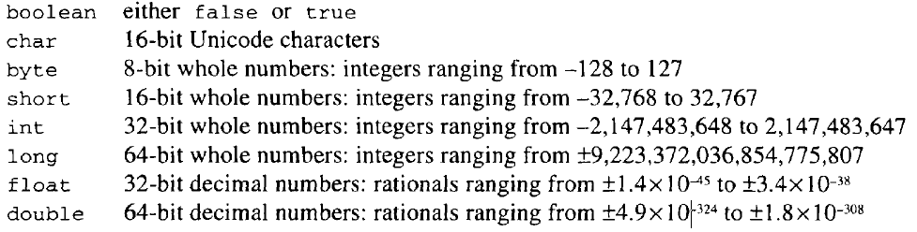
cnt’d…
Besides reference types, there are eight other types in Java. These are called primitive types, to distinguish them from reference types - to store the locations of objects in the computer’s memory.
Their names and values are:

Slide 16
Constants
A constant is any expression that has a fixed value.
Like variables, constants are data storage locations in the computer memory. But, constants, unlike variables their content cannot be changed after the declaration.
Constants must be initialized when they are created by the program, and the programmer can’t assign a new value to a constant later.
E.g.:
final int x =15; (cant be modified eg- array size)
int x=10;

Slide 17
Operators
An operator is a symbol that makes the machine to take an action.
Different Operators act on one or more operands and can also have different kinds of operators.
C++ provides several categories of operators, including the following:
Assignment operator eg: x=3;or x+=3;
Arithmetic operator (+,-,*,/,%)
Relational operator (>,<,>=,<=,==,!=)
Increment/decrement operator

Slide 18
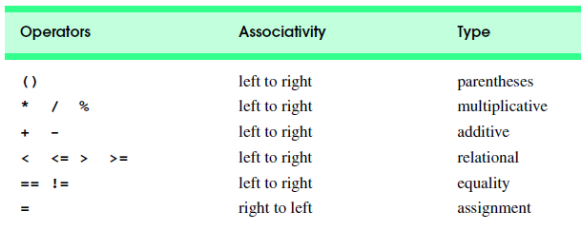
Cont…
E.g. int k = 5;
(auto increment prefix) y= ++k + 10; //y=
(auto increment postfix) y= k++ + 10; //y=
(auto decrement prefix) y= --k + 10; //y=
(auto decrement postfix) y= k-- + 10; //y=
Operator Precedence

Slide 19
Simple Type Conversion/Casting
A value in any of the built-in types we have seen so far can be converted (type-cast) to any of the other types.
For example: (int) 3.14 // converts 3.14 to an int 3
(double) 2 // converts 2 to a double to give 2.0
(string) 122 // converts 122 to a string whose code=122
Integer division always results in an integer outcome.
Division of integer by integer will not round off to the next integer
E.g.: 9/2 gives 4 not 4.5
E.g 8.2/2=4.1 implicit conversion/promotion

Slide 20
Basic Classes
1. System: one of the core classes the easiest way to display information
System class is final and all of it’s members and methods are static
System.out.println( "Welcome to Java!" );
System.out.print(“…”);
System.exit(0);
New line usage
System.out.println( "Welcome\nto\nJava\nProgramming!" );

Slide 21
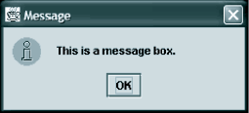
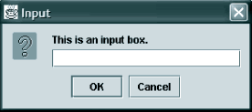
Cont…
2. Scanner:
The java.util.Scanner class is a simple text scanner which can parse primitive types and strings using regular expressions.
Methods: next(), nextInt()…
Eg:- Scanner s=new Scanner (System.in);
int x=s.nextInt();
3. JOptionPane
The JOptionPane class provides static methods to display each type of dialog box.

Slide 22
Cont…
Eg:
String x =JOptionPane.showInputDialog( "Enter first integer" );
JOptionPane.showMessageDialog( null, “result" + sum, “Title",ICON-sign); ICON-sign: JOptionPane.PLAIN_MESSAGE
The following statement must be before the program’s class header(tells the compiler where to find the JOptionPane class)
import javax.swing.JOptionPane;
A program that uses JOptionPane does not automatically stop executing when the end of the main method is reached.
Java generates a thread, which is a process running in the computer, when a JOptionPane is created.
If the System.exit method is not called, this thread continues to execute.

Slide 23
Examples:
Import java.util.Scanner;
int number1,number2,sum;
Scanner s=new Scanner(System.in);
number1 = s.nextInt();
number2 = s.nextInt();
sum = number1 + number2;
System.out.println(“Result=”+sum);

Slide 24
Examples:
import javax.swing.JOptionPane;
String firstNumber,secondNumber
int number1,number2,sum
firstNumber =JOptionPane.showInputDialog( "Enter first integer" );
secondNumber = JOptionPane.showInputDialog( "Enter second integer" );
number1 = Integer.parseInt( firstNumber );
number2 = Integer.parseInt( secondNumber );
sum = number1 + number2;
JOptionPane.showMessageDialog( null, "The sum is " + sum, "Results", JOptionPane.PLAIN_MESSAGE );
System.exit( 0 );

Slide 25
4. Type-classes
Eg: Integer, String, Double…
Works with Parse-methods:
Parse methods convert strings to numeric data types
String x; int y,z;
Integer.parseInt(x)
Double.parseDouble(x)
Integer.toString(y);
Integer.compare(y,z);-comparison
Integer.max(y,z);
String; charAt(x)
String name;
for(i=0;i<name.length();i++)
System.out.println(name.charAt(i));

Slide 26
5. Math-class
The java.lang.Math class contains methods for performing basic numeric operations such as the elementary exponential, logarithm, square root, and trigonometric functions
Eg: Math.ceil(x)
Math.floor(x)
Math.PI;
Math.sin(x);
Math.pow(x,y)
Math.round(x)
Math.max(x,y)
Math.toDegrees(x);
Math.random(): a random floating point number between 0 and 1. generates a double value in the range [0,1)
Eg: Math.random()*100

Slide 27
Cont…
In order to produce random "integer" values within a specified range,
you need to manipulate the random( ) method.
Obviously, we will need to cast our value to force it to become an integer.
The formula is:
int x = (int) (min + Math.random( ) * (Max - Min + 1));
Eg: random numbers between 1 to 10
Int x= (int) (1 + Math.random( ) * (10 - 1 + 1));
Int x= (int) (1 + Math.random( ) * 10);
Int x=(int) 1+(0.63*10)=7

Slide 28
6. Random
Random is a class used to generate random numbers between the given lists/ranges.
Example:
public class RANDOM1 {
public static void main(String[] args) {
double x []=new double[20];
Random r=new Random();
int sum=0;
Scanner s=new Scanner(System.in);
for(int i=0;i<5;i++)
{x[i]=r.nextInt(100);//nextDouble()*100
//it excludes the top-value so we add 1
//int randomNum = rand.nextInt((max - min) + 1) + min;
System.out.println(x[i]);
}
}}

Slide 29
Basic Control Structures
1. Conditional Statements
Conditional statements like if, if-else, if-else-if and switch can also be used in java as of their syntax
Example of if-statement
public class Even
{
public static void main(String args[] )
{
int x;
for (x=0;x<=10;x++)
if(x%2==0)
System.out.println("evens="+x);
}}

Slide 30
2. Looping structure
Do-while, for and while repetition statements are also applicable in java
Eg:-displaying all squares of numbers 1 to 10
public static void main(String args[])
{ String output=" ,";
Int n=10;
System.out.println(“the output is=”);
Int i=1;
do {
output +=i*I;
i++;
}
while(i<=n);
System.out.println(output); }

Slide 31
For-each
Advanced or Enhanced For loop
The for-each loop introduced in Java5. It is mainly used to traverse array or collection elements.
Advantage of for-each loop:
It makes the code more readable.
It elimnates the possibility of programming errors.
Syntax :
for(data_type variable : array | collection){}
Eg:-
int arr[]={12,13,14,44};
for(int i:arr){
System.out.println(i);
}

Slide 32
3. Branching statement
Reading Assignment : How do we use the following Branching statements in Java?
Continue, break, goto
???

Slide 33
Arrays
A static data structure-
Sysntax:
Data type arrayname[]=new dataType[size];
Int x[]=new int[20];
Example-
import java.util.*;
public class array1 {
public static void main(String[] args) {
int x []=new int[20];//array declaration
int sum=0;

Slide 34
Cont…
Scanner s=new Scanner(System.in);
System.out.println("enter the numbers");
for(int i=0;i<5;i++)
{ x[i]=s.nextInt();
System.out.println(x[i]);
S=s+x[i];
}
System.out.println("result="+s);
}}

Slide 35
Array-Lists
Arraylist is a class which implements List interface. It is widely used because of the functionality and flexibility it offers. Most of the developers choose Arraylist over Array as it’s a very good alternative of traditional java arrays.
ArrayList can dynamically grow and shrink as per the need. Apart from these benefits ArrayList class enables us to use predefined methods of it which makes our task easy
Syntax for string list
ArrayList<String> obj = new ArrayList<String>();

Slide 36
Example
import java.util.*;
public class EGARRAYLIST {
public static void main(String args[]){
int sum=0;
ArrayList<Integer> x=new ArrayList<Integer>();
Scanner s=new Scanner(System.in);
System.out.println("enter the numbers");
for(int i=0;i<5;i++){
x.add(s.nextInt());
sum=sum+x.get(i);}

Slide 37
Cont…
System.out.print("res===,"+sum);
for(int i=0;i<5;i++)
{ //x.add(i);
System.out.println(x.get(i));
}}
}
Eg-2
ArrayList<String> list=new ArrayList<String>();
list.add(“banana");
list.add(“Apple");
list.add(“orange");
for(String s:list){
System.out.println(s);
}

Slide 38
Methods-User defined
Methods also defined outside main and called in the main whenever necessary.
Example:
import java.util.Scanner;
public class Func1 {
public static void main(String[] args)
{
pr();
Func1.pr2();
}

Slide 39
Cont…
public static void pr()
{System.out.println("hello");
}
public static void pr2()
{ int x,y,r;
Scanner s=new Scanner (System.in);
System.out.println ("enter...");
x=s.nextInt(); y=s.nextInt();
r=x+y;
System.out.println("res="+r);}

Slide 40
Exercises
Addition of two numbers using Scanner
Addition of two numbers using JOptionPane
Checking the number even or not…using if
Displaying all squares of 1 to 10..using do while

